Slide 1

Sales Analysis Project
By
Ms. Diksha Ramteke

Slide 2
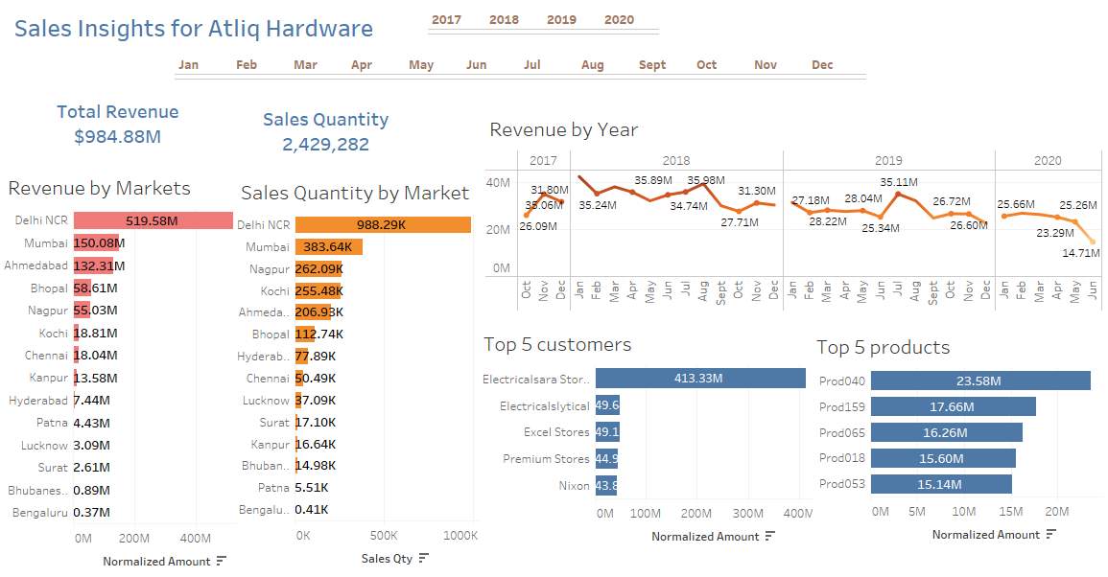

Slide 3
